Slide 1
SWEG2071
Web Design and Programming
SWENG
AASTU
March 2018

Slide 2
Chapter 2
Webpage Development Using HTML

Slide 3
Objectives
After completing this chapter you should be able to:
  Define HTML
  Understand and use HTML tags
  Create webpages using HTML

Slide 4
Content
What is HTML?
Basic Syntax
Creating HTML Documents
Basic Tags
Lists
Hypertext links

Slide 5
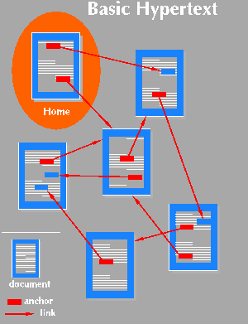
Hypertext
Hypertext is text with links to further information
Electronic docs cross-referenced
They can be anywhere in the world.
Browsing: navigation by wandering from one page to another.

Slide 6
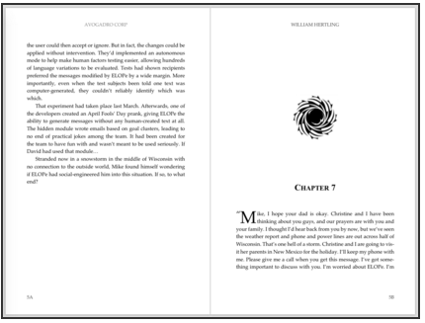
Markup Language
Text-formatting language
“markup” – from printing

Slide 7
What is HTML?
HTML stands for Hyper Text Markup Language
Define the structure of information on the Web page.
HTML is not a programming language, it is a markup language
A markup language is a set of markup tags
HTML uses markup tags to describe web pages
Built using SGML (Standard Generalized Markup Language) - is a standard for specifying a markup language or tag set

Slide 8
Recent Versions
HTML 4.0 – 1997
  Introduced many new features and deprecated many older features
HTML 4.01 - 1999 - A cleanup of 4.0
XHTML 1.0 - 2000
  Just 4.01 defined using XML, instead of SGML
XHTML 1.1 – 2001
  Modularized 1.0, and drops frames
XHTML 2.0 – development abandoned
HTML 5.0 – 2014
  HTML and XHTML syntax

Slide 9
Editing HTML
Creating HTML documents
  Text editors (e.g. Notepad, Emacs, Crimson Editor)
  Source code editors (e.g. Notepad++, WebTide)
  Authoring tools (e.g. Microsoft Expression Web, Adobe Dreamwaver, KompoZer)
HTML files have .html (.htm) extension

Slide 10
HTML Document Structure
An HTML document is composed of 3 parts:
a line containing HTML version information, e.g.:
<!DOCTYPE html> for HTML5
header section
  Delimited with the <head> tag
  The <title>tag is used to give the document a title
    normally displayed in the browser’s window title bar
a body containing the document's actual content
  Delimited with the <body> tag
After document type declaration, the remainder of an HTML document is contained by the html element

Slide 11
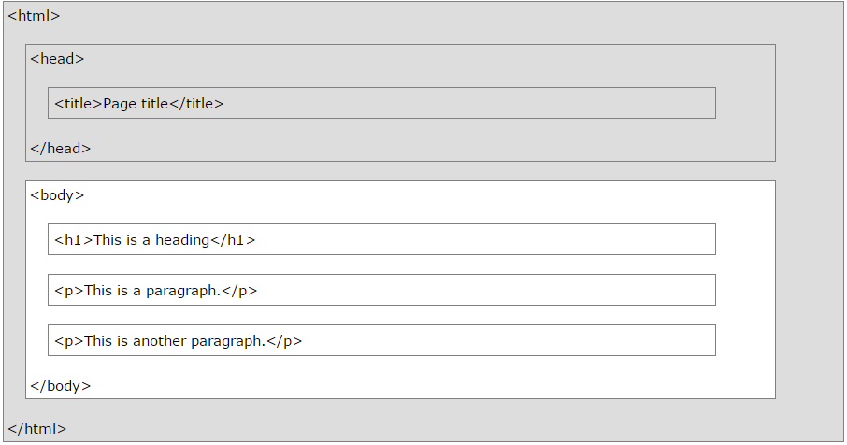
Only the <body> area (the white area) is displayed by the browser.

Slide 12
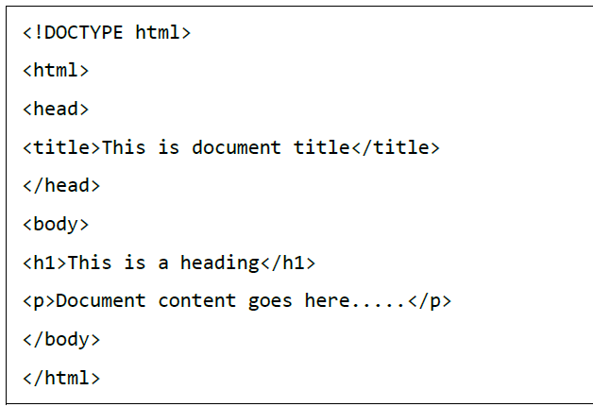
A simple HTML document
Save it as test.htm using a text editor, and open

Slide 13
HTML Tags
Define the structure of information on the Web pages
Tag format:
  Opening tag: <name>
  Closing tag: </name>
The opening tag and its closing tag together specify a container for the content they enclose
  E.g.
Not all tags have content:
  Block tags: have content. E.g.
  Inline tags: no. E.g.
Not case sensitive

Slide 14
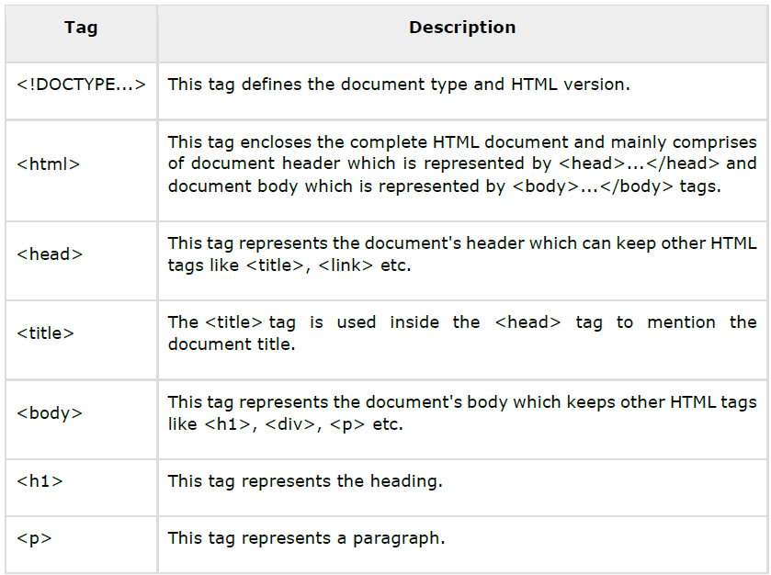
HTML Tags
Learning HTML is simply studying various tags and their usage
HTML Tags Ordered Alphabetically

Slide 15
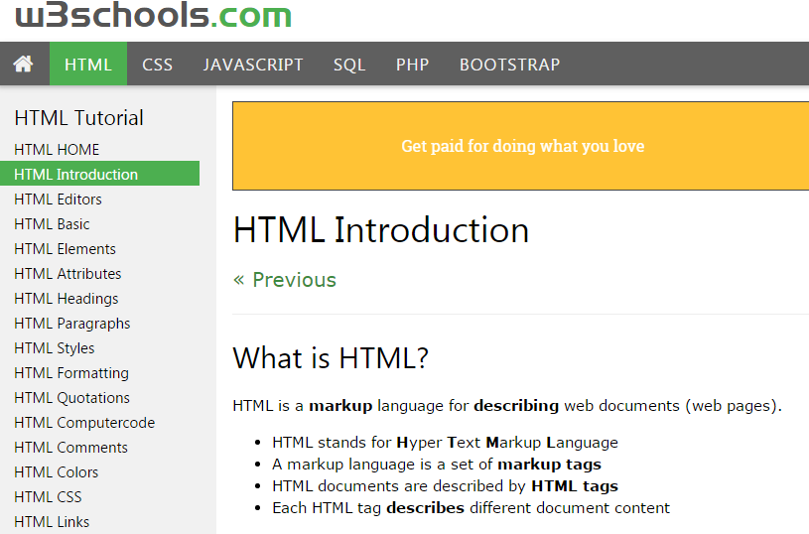
Web developer website:
- online editor provided
- you can edit the examples and execute the code

Slide 16
Basic Tags
Heading Tags
  HTML has six levels of headings: <h1>, <h2>, <h3>, <h4>, <h5>, and <h6>.
  While displaying any heading, browser adds one line before and one line after that heading

Slide 17
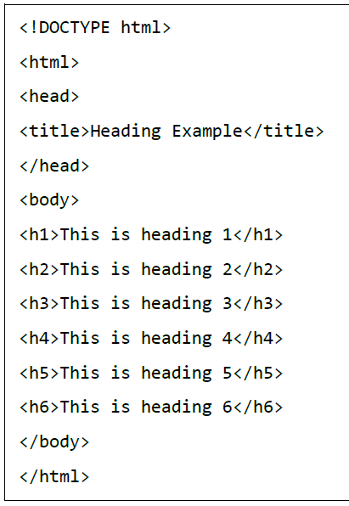
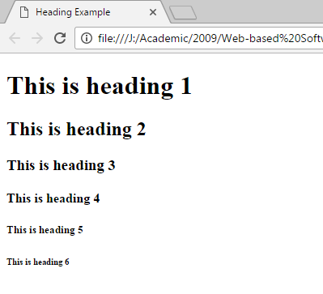
Example

Slide 18
Basic Tags . . .
Paragraph Tag
  The <p> tag offers a way to structure your text into different paragraphs
  <p> …paragraph text…</p>
  The browser puts as many words of the paragraph’s content as will fit in each line, line breaks ignored.

Slide 19
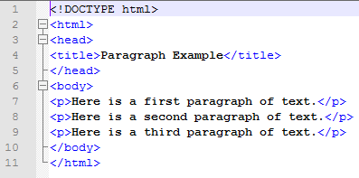
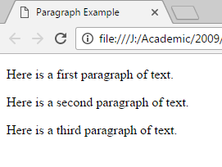
Example

Slide 20
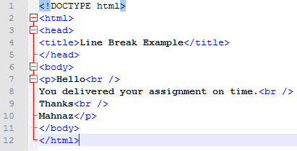
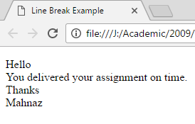
Basic Tags . . .
Line Break Tag
  <br />, anything following it starts from the next line.
  This tag is an example of an empty element
  The <br /> tag has a space between the characters br and the forward slash

Slide 21
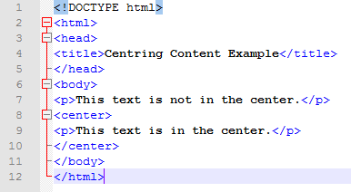
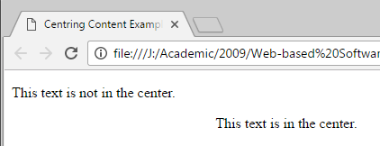
Basic Tags . . .
Centering Content
  You can use <center> tag to put any content in the center of the page or any table cell

Slide 22
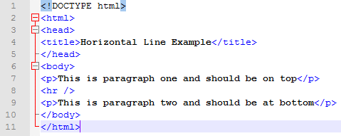
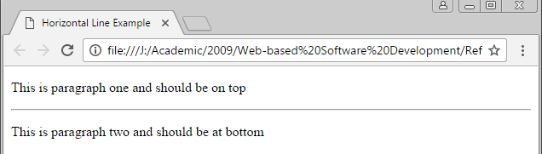
Basic Tags . . .
Horizontal Lines
  Horizontal lines are used to visually break-up sections of a document.
  The <hr> tag creates a line

Slide 23
Basic Tags . . .
Horizontal Lines Attributes:
  width=“width” {absolute: in pixels or relative: in %}
  Noshade, renders the bar without a surrounding shadow
  color=“color”
  Align={left,right,center}
  Size= { changes the size}, sets the bar's thickness (height) in pixels
  E.g. <hr width=“75%” noshade color=“#FF0000”>

Slide 24
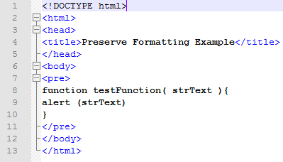
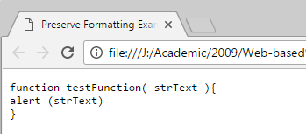
Basic Tags . . .
Preserve Formatting
  If you want a text to follow the exact format of how it is written in the HTML document
  <pre> . . . </pre>

Slide 25
HTML Elements
The container and its content together are called an element
An HTML element is defined by a starting tag
If the element contains other content, it ends with a closing tag

Slide 26
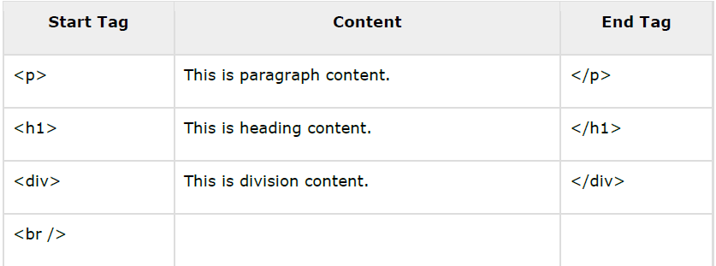
HTML Elements
<p>....</p> is an HTML element,
<h1>...</h1> is another HTML element.
Some HTML elements don't need to be closed, e.g: <img.../>, <hr /> and <br /> elements, void elements.

Slide 27
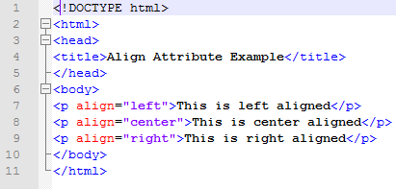
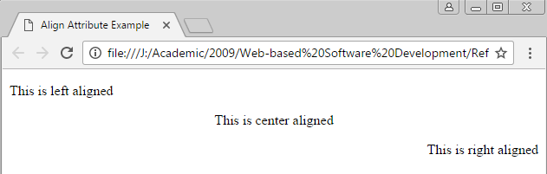
Attributes
HTML elements can have attributes
Attributes provide additional information about an element
Attributes are always specified in the start tag
Attributes come in name/value pairs like: name="value"

Slide 28
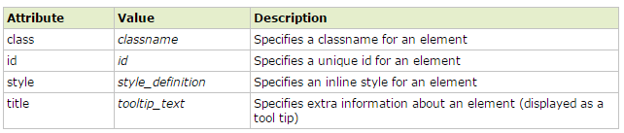
Core Attributes
For Complete Attribute Reference visit:
w3schools.com

Slide 29
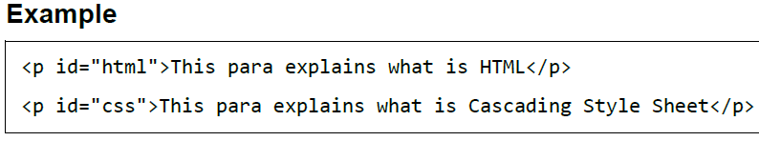
Core Attributes . . .
The Id Attribute
  used to uniquely identify any element within an HTML page, two primary reasons for use:
    to identify just that element and its content
    distinguish between elements that have the same name.

Slide 30
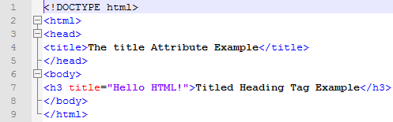
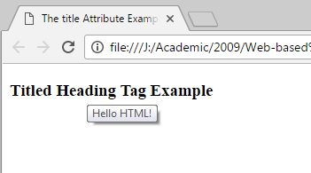
Core Attributes . . .
The title Attribute
  gives a suggested title for the element to identify just that element and its content
  often displayed as a tooltip

Slide 31
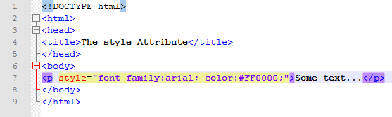
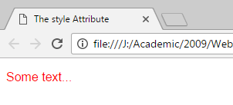
Core Attributes . . .
The class Attribute
  used to associate an element with a style sheet, and specifies the class of element
  More on this when you learn CSS
The style Attribute
  allows you to specify Cascading Style Sheet (CSS) rules within the element

Slide 32
Formatting
Bold Text
Italic Text
Underlined Text

Slide 33
Formatting . . .
Strike Text
Monospaced Font
  Most of the fonts are known as variable-width fonts because different letters are of different widths
  E.g: 'm' is wider than the letter 'i')
  In a monospaced font, however, each letter has the same width.

Slide 34

Formatting . . .
Superscript Text
Subscript Text
Inserted & deleted Text

Slide 35
Formatting . . .
Larger Text
Smaller Text
Emphasized Text

Slide 36
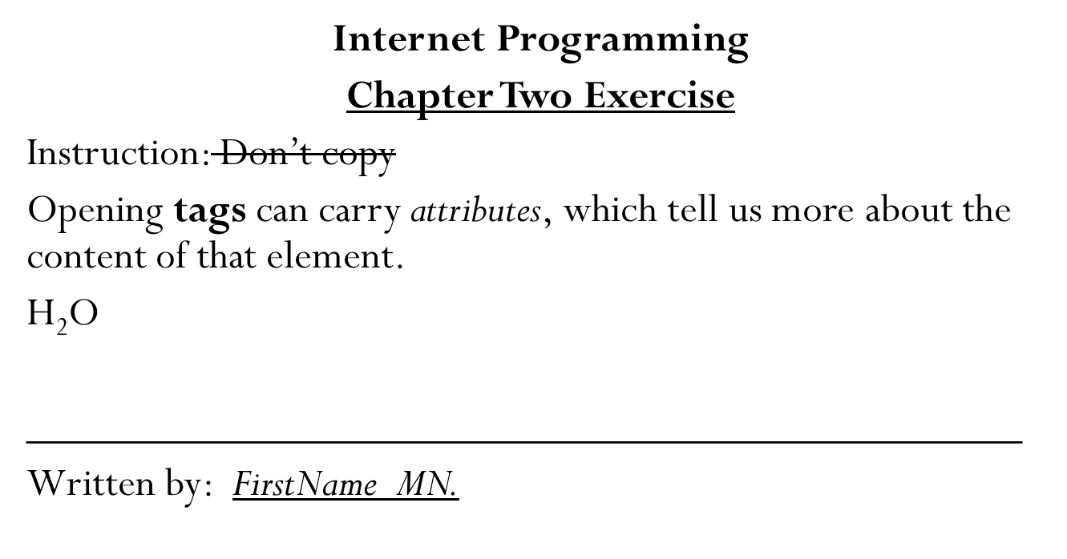
Exercise: create the following

Slide 37


Formatting . . .
Marked Text
Strong Text
Text Abbreviation
  If present, the title attribute must contain its full description

Slide 38
Formatting . . .
Marked Text
Strong Text
Text Abbreviation
  If present, the title attribute must contain its full description

Slide 39

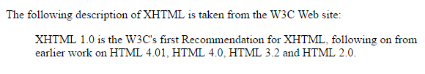

Formatting . . .
Quoting Text
Short Quotations

Slide 40

Formatting . . .
Computer Code
Programming Variables
  This element is usually used in conjunction with the <pre> and <code> elements to indicate that the content of that element is a variable. For example with <code>:

Slide 41

Formatting . . .
Program Output
Address Text

Slide 42
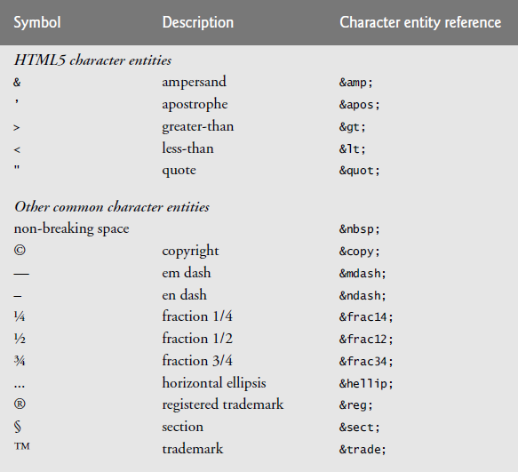
Special Characters
When marking up text, certain characters or symbols may be difficult to embed directly into an HTML5 document

Slide 43
Meta Tags
HTML lets you specify metadata –
  additional important information about a document in a variety of ways.
  The META elements can be used to include name/value pairs describing properties of the HTML document
    E.g.: expiry date, a list of keywords, document author etc.
  The <meta> tag is used to provide such additional information,
  it is an empty element but it carries information within its attributes.
  You can include one or more meta tags in your document
  meta tags do not impact physical appearance of the document

Slide 44
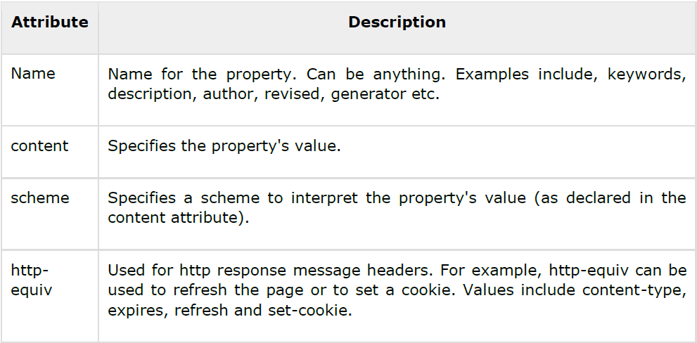
Adding Meta Tags to Your Documents
Add metadata to your web pages by placing <meta> tags inside the header of the document
A meta tag can have following attributes in addition to core attributes:

Slide 45
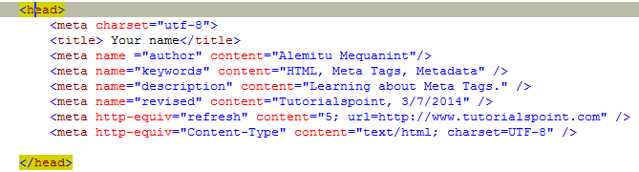
Adding Meta Tags to Your Documents

Slide 46
Meta Tags increase Findability
Search engines catalog sites by following links from page to page (often known as spidering or crawling the site) and saving identification and classification information for each page.
One way that search engines catalog pages is by reading the content in each page’s meta elements, which specify information about a document.
Using the meta element helps to maximize website findability and improve your rankings search engine results.

Slide 47
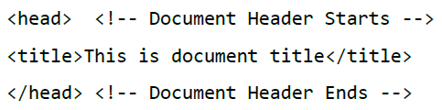

HTML – COMMENTS
Comments help you and others understand your code and increases code readability.
<!-- comment --> tags
Multiple lines also possible,

Slide 48
Images
Formats:
  GIF (Graphic Interchange Format)
    8-bit color representation (256 different colors)
  JPEG (Joint Photographic Experts Group)
    24-bit colour representation (16 million different colours)
  Portable Network Graphics (PNG)
    Relatively new
    Designed for transferring images on the Internet

Slide 49
Images …
Images are inserted into a document with the <img> tag with the src attribute
The alt attribute is required by HTML
  If image ignored
  Non-graphical browsers
  Browsers with images turned off
<img src = “logo.jpg“ alt = “AASTU Logo" />
The <img> tag has other optional attributes, including width and height (in pixels)

Slide 50
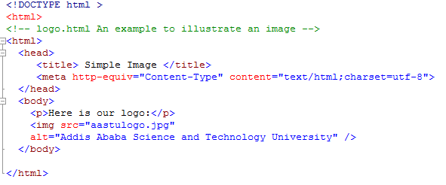
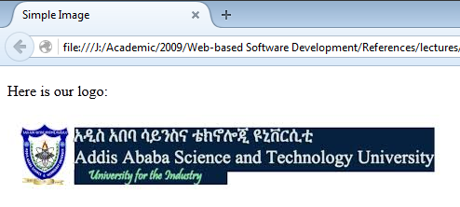
Example:

Slide 51
Linking on the Web
Source
Anchor
Document 1
Here is a link to document 2
Link (reference)
Destination
Document 2
This is document 2.
Link acts as a pointer to some particular place in some Web resource

Slide 52
Hypertext Links
Hypertext is the essence of the Web!
A link is specified with the href (hypertext reference) attribute of <a> (the anchor tag)
The content of <a> is the visual link in the document
E.g. <a href=“target.html”>This is a link</a>
  The href attribute is set to the URL of the target resource
    href=“url”
  target=“target” { _self, _blank }: loads in a particular frame or window
    _blank - Opens the linked document in a new window or tab
    _self - Opens the linked document in the same window/tab as it was clicked (this is default)

Slide 53
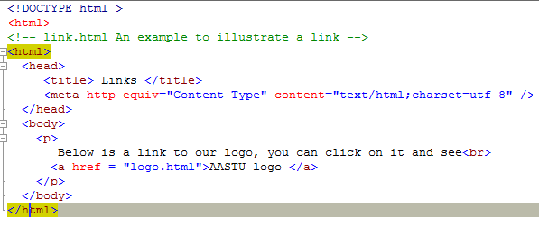
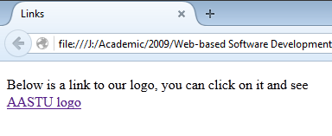

Slide 54
Hypertext Links
If target is in another document:
  In same directory: document’s file name
    E.g. c210data.html
  In other directory- the UNIX pathname
    E.g. airplanes/c210data.html
  Target document is loaded and displayed, replacing the source document.
Relative addressing of targets is easier to maintain and more portable than absolute addressing

Slide 55
Targets within Documents
If the target is not at the beginning of the document, the target spot must be marked
Target labels can be defined in many different tags with the id attribute.
<h1 id = "baskets"> Baskets </h1>
The link to an id must be preceded by a pound sign (#)
  target is in the same document,
<a href = "#baskets"> Baskets </a>
  target is a fragment of different document
<a href = "myAd.html#baskets”> Baskets </a>

Slide 56
Example
<html>
<head><title>Bottom, Middle, Top</title></head>
<body>
<p>
Go to the <a href="#bottom" id="Top">bottom</a> of this document.<br />
<p>To make this work we need to simulate the document being very
long by using many breaks.
<br /><br /><br /><br /><br /><br /><br /><br /><br />
<br /><br /><br /><br /><br /><br /><br /><br /><br /><br /><br /><br /><br /><br /><br /><br /><br /><br />
<strong id="middle">the middle</strong>
<br /><br /><br /><br /><br /><br /><br /><br /><br /><br /><br /><br /><br /><br /><br /><br /><br /><br />
<br /><br /><br /><br /><br /><br /><br /><br /><br /><br /><br /><br /><br /><br /><br /><br /><br /><br />
<hr />
<p><a id="bottom" name="bottom" href="#Top">return to top</a>
<a href="#middle">go to middle</a></p>
</body>
</html>

Slide 57
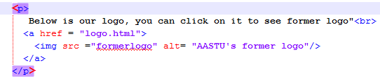
Image Hyperlinks
Links can include images in their content
  i.e. images as content of the anchor element

Slide 58
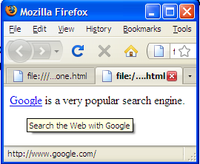

Linking to a website
to link to a different site you need to write the URL between the <a> and </a> tags - source anchor,
You can include title attribute to links – when the mouse is over the link additional information could be delivered to the user.
<body>
You can also <a href="http://www.google.com/"> search Google </a>?
</body>

Slide 59

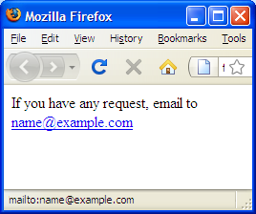
Linking to E-mail Addresses
To create a link to an e-mail address you need to use the following syntax with the <a> element:

Slide 60
Lists
HTML provides simple and effective ways to specify lists in documents.
List types:
  Unordered lists
  Ordered lists
  Definition lists

Slide 61

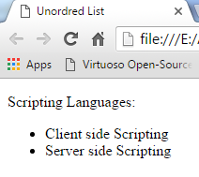
Unordered Lists
Bullet points, order doesn’t matter
The <ul> tag, which is a block tag, creates an unordered list.
Each item in a list is specified with an <li> tag
Atribute: type=“bullet type” {disc, circle, square}

Slide 62
Exercise: Create the following
Programming Languages
  C++
  Java
  C#
Internet Programming Concepts
  Internet
  HTTP
  URL
  HTML

Slide 63
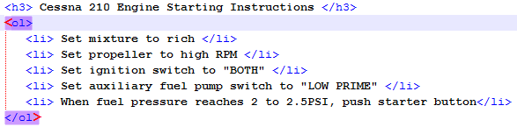
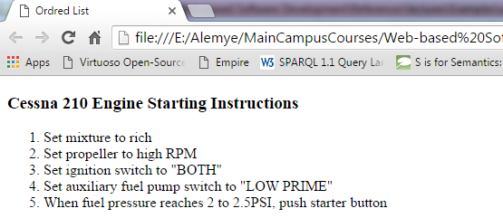
Ordered Lists
Order of items is important.
Each item in the display is preceded by a sequence value, default is Arabic numerals. Atribute: type=“number type” {1, i, I, a, A}
The list is the content of the <ol> tag

Slide 64
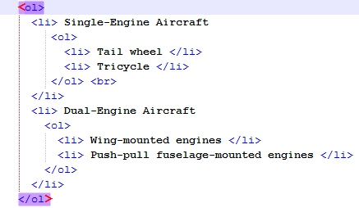
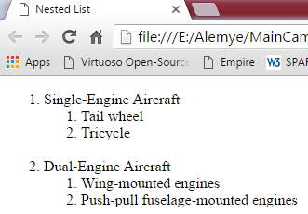
Nested Lists
Any type list can be nested inside any type list
The nested list must be in a list item

Slide 65
Exercise: Create the following
Hardware
  Input Device
    Keyboard
    Mouse
  CPU
  Output Device
  Storage Device
Software
  System Software
  Application Software
    Database software
      SQL Server
      My Sql
      Oracle
    Programming Software
      C++
      java

Slide 66
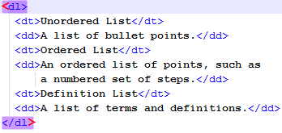
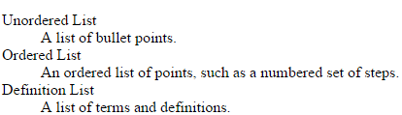
Definition Lists (for glossaries)
  Allow to specify a term and its definition or description
List is the content of the <dl> tag
Terms being defined are the content of the <dt> tag
The definitions themselves are the content of the <dd> tag

Slide 67
Validation
W3C HTML Validation Service
  http://validator.w3.org/

Slide 68
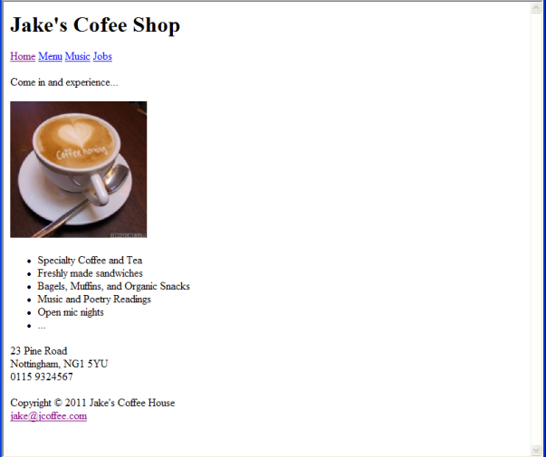
Exercise: Crete the following page

